Slide 1
Implementation of GANs on Anime faces
Rahul Mishra
Nishanth Vimalesh
ECE 592
Topics in Data Science

Slide 2
Content
Problem Statement
Generative Models
Generative Adversarial Networks (GAN)
Framework
Theory
Algorithm
Implementation
Deep Convolutional GAN
Results
References
Q&A

Slide 3

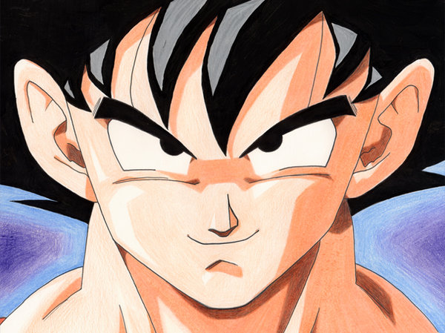


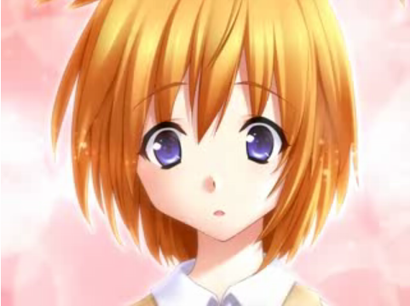

Problem Statement
Artificially generate Anime faces
(Generative Adversarial Networks)
Dataset: Moe Imouto Faces
- 14387 anime faces
This Photo by Unknown Author is licensed under CC BY-SA
This Photo by Unknown Author is licensed under CC BY-NC
This Photo by Unknown Author is licensed under CC BY-NC-ND
This Photo by Unknown Author is licensed under CC BY-SA
This Photo by Unknown Author is licensed under CC BY-SA
This Photo by Unknown Author is licensed under CC BY-SA

Slide 4
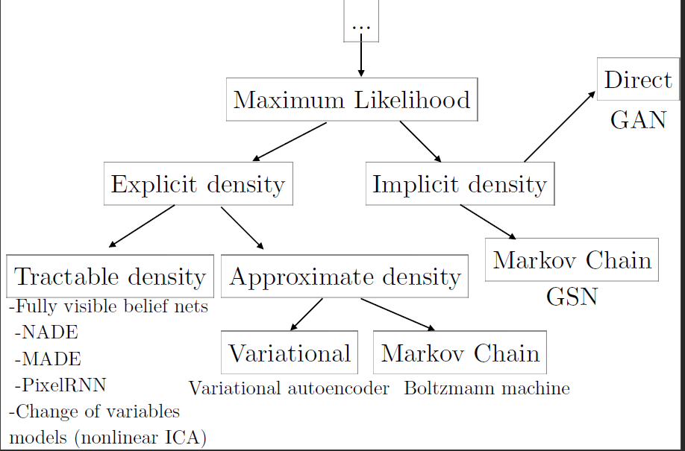
Generative Models

Slide 5
GAN | Framework
p_{data}(x)
x
(sampled from data)
Discriminator
D(x,θ_{d})
Predicted label
Generator
G(z,θ_{g})
p_{g}
p_{z}(z)
z
x
(input noise)
(sampled from model)
Value Function: $\underset{G}{\underbrace{min}}\underset{D}{\underbrace{max}}V\left(D,G\right)=E_{x\sim p_{data}(x)}\left[logD\left(x\right)\right]+E_{z\sim p_{z}(z)}[log⁡(1−D(G(z)))]$

Slide 6
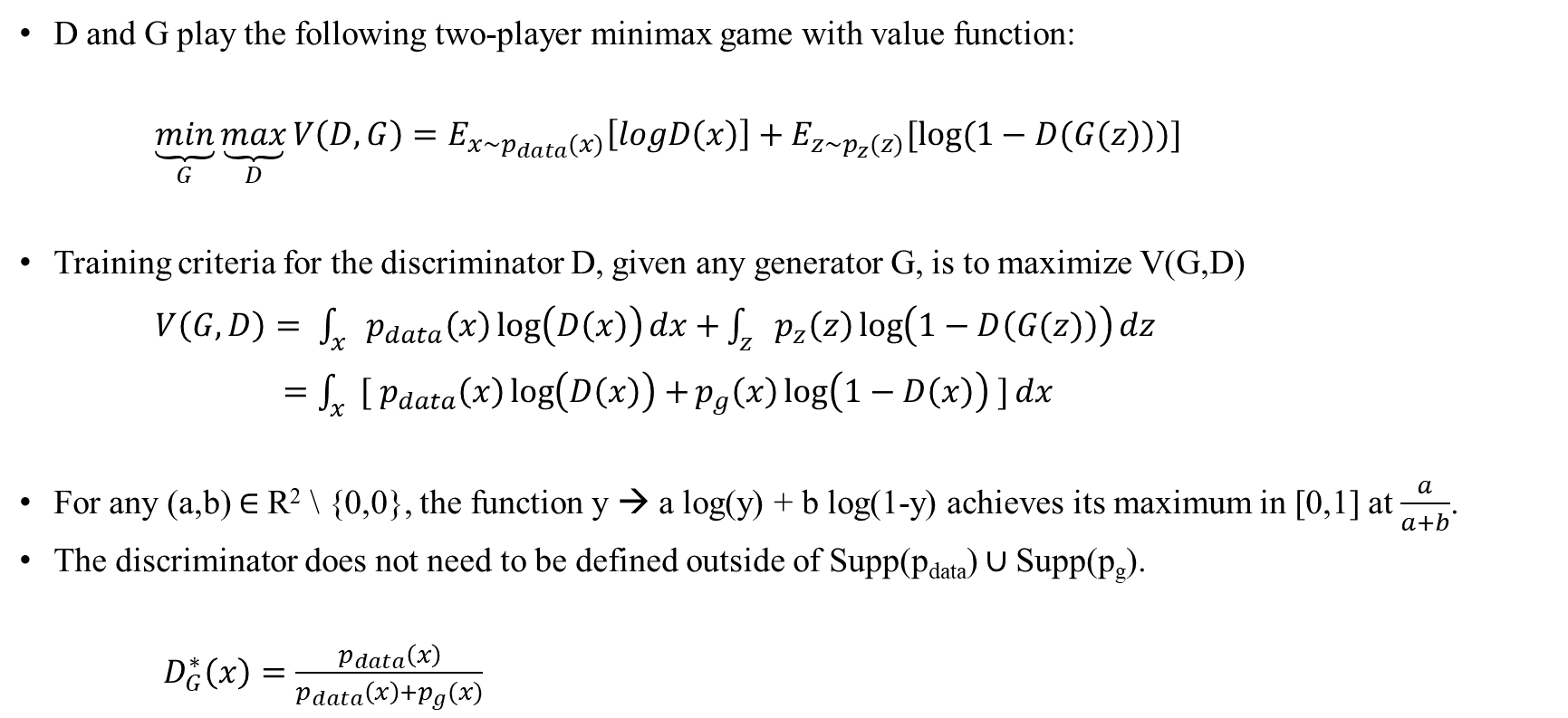
GAN | Theory
D and G play the following two-player minimax game with value function:
$\underset{G}{\underbrace{min}}\underset{D}{\underbrace{max}}V\left(D,G\right)=E_{x\sim p_{data}(x)}\left[logD\left(x\right)\right]+E_{z\sim p_{z}(z)}[log⁡(1−D(G(z)))]$
Training criteria for the discriminator D, given any generator G, is to maximize V(G,D)
$V\left(G,D\right)= \int_{x}{p_{data}\left(x\right)\log\left(D\left(x\right)\right)dx+}\int_{z}{p_{z}\left(z\right)\log\left(1−D\left(G(z)\right)\right)dz}$
$=\int_{x}{{[ p}_{data}\left(x\right)\log\left(D\left(x\right)\right)+}p_{g}\left(x\right)\log\left(1−D\left(x\right)\right) ]dx$
For any (a,b) $∈$R² \ {0,0}, the function y → a log(y) + b log(1-y) achieves its maximum in [0,1] at $\frac{a}{a+b}$.
The discriminator does not need to be defined outside of Supp(p_{data}) $∪$Supp(p_{g}).
$D_{G}^{∗}\left(x\right)=\frac{p_{data}\left(x\right)}{p_{data}\left(x\right)+p_{g}(x)}$

Slide 7
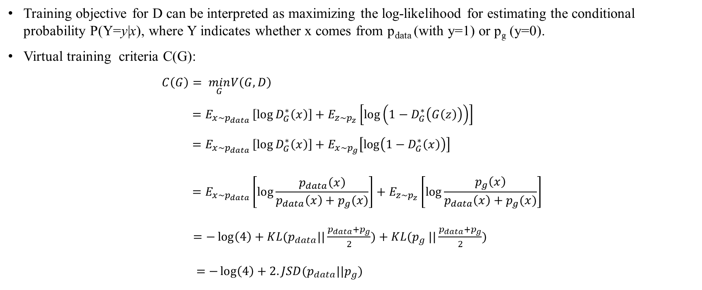
GAN | Theory Continued…
Training objective for D can be interpreted as maximizing the log-likelihood for estimating the conditional probability P(Y=y|x), where Y indicates whether x comes from p_{data} (with y=1) or p_{g} (y=0).
Virtual training criteria C(G):
$$C\left(G\right)= \min_{G}V\left(G,D\right) \\ =E_{x\sim p_{data} }\left[\log{D_{G}^{∗}\left(x\right)}\right]+E_{z\sim p_{z}}\left[\log\left(1−D_{G}^{∗}\left(G\left(z\right)\right)\right)\right] \\ =E_{x\sim p_{data} }\left[\log{D_{G}^{∗}\left(x\right)}\right]+E_{x\sim p_{g}}\left[\log\left(1−D_{G}^{∗}\left(x\right)\right)\right] \\ { =E}_{x\sim p_{data} }\left[\log{\frac{p_{data}\left(x\right)}{p_{data}\left(x\right)+p_{g}(x)}}\right]+E_{z\sim p_{z}}\left[\log{\frac{p_{g}\left(x\right)}{p_{data}\left(x\right)+p_{g}(x)}}\right]$$ $=−\log\left(4\right)+KL(p_{data}||\frac{p_{data}+p_{g}}{2})+KL(p_{g} ||\frac{p_{data}+p_{g}}{2})$
$=−\log\left(4\right)+2.JSD(p_{data}||p_{g})$
Jensen-Shannon Divergence between two distribution is always non-negative, and zero iff they are equal.
C* = -log(4) is the global minima of C(G)
Only solution is p_{g} = p_{data}, i.e., generative model perfectly replicating the data distribution.

Slide 8
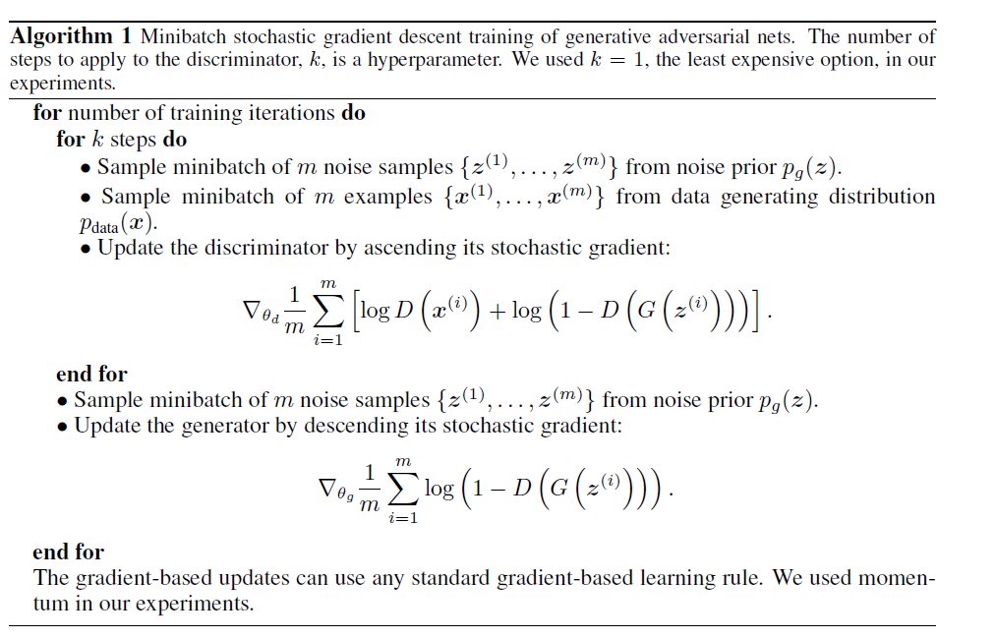
GAN | Algorithm

Slide 9
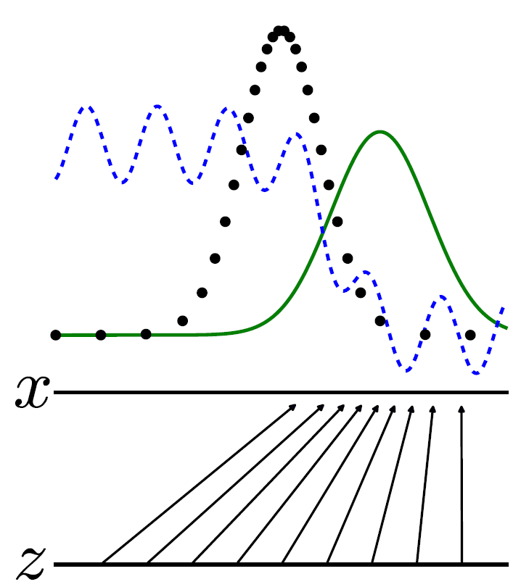
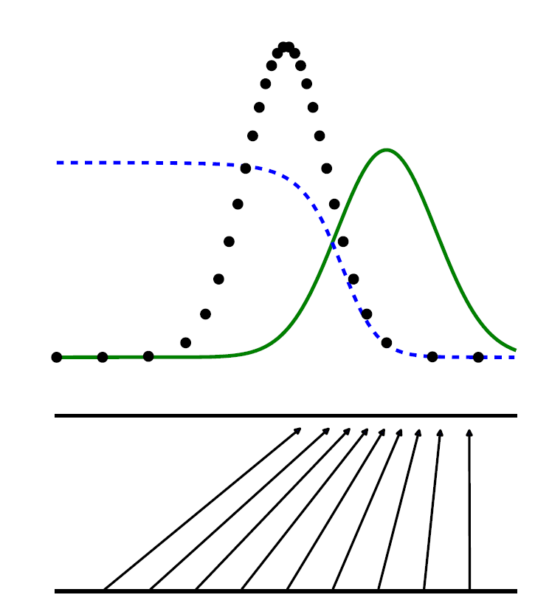
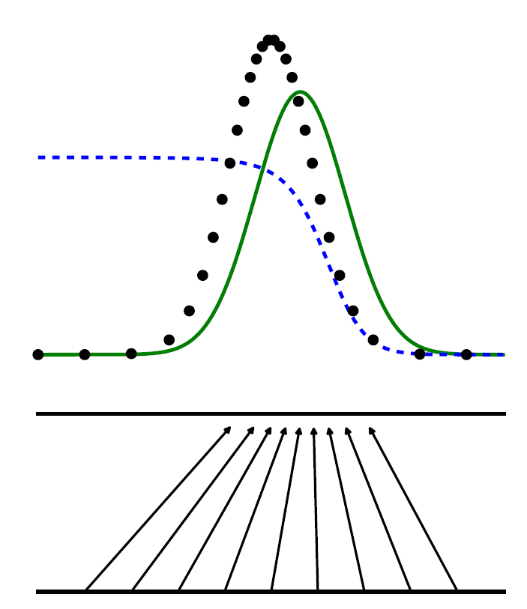
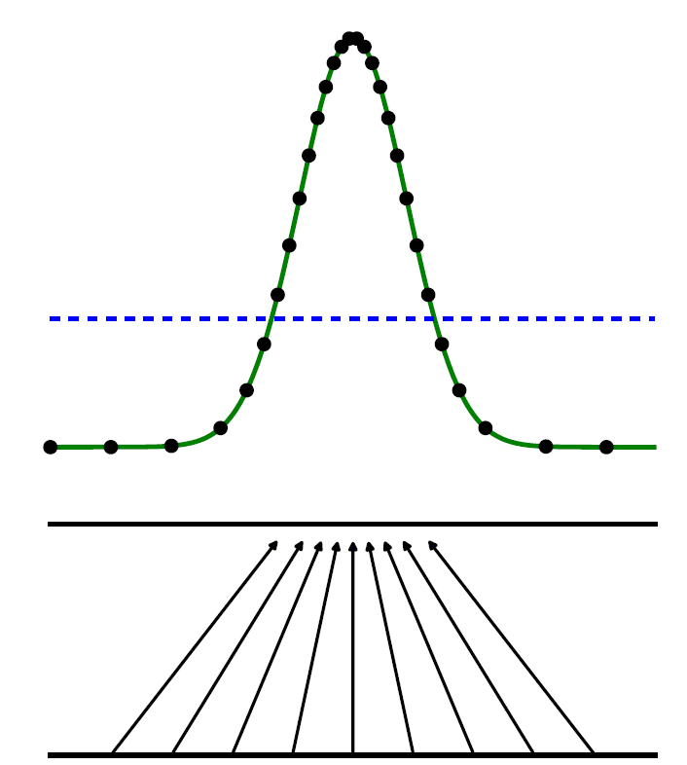
GAN | Algorithm | Representation Close to Convergence
Data Generating Distribution (p_{x})
Discriminative Distribution
Generative Distribution (p_{g})
The upward arrow shows how the mapping x = G(z) imposes the non-uniform distribution p_{g} on transformed samples.
G contracts in region of high density and expands in region of low density of p_{g}.
p_{g} is similar to p_{data}
D in its inner loop is trained to discriminate samples from data.
After an update to G, gradient of D has guided G(z) to flow to region to befool D.
No further improvement in either G and D is possible. D(x) = 1/2

Slide 10
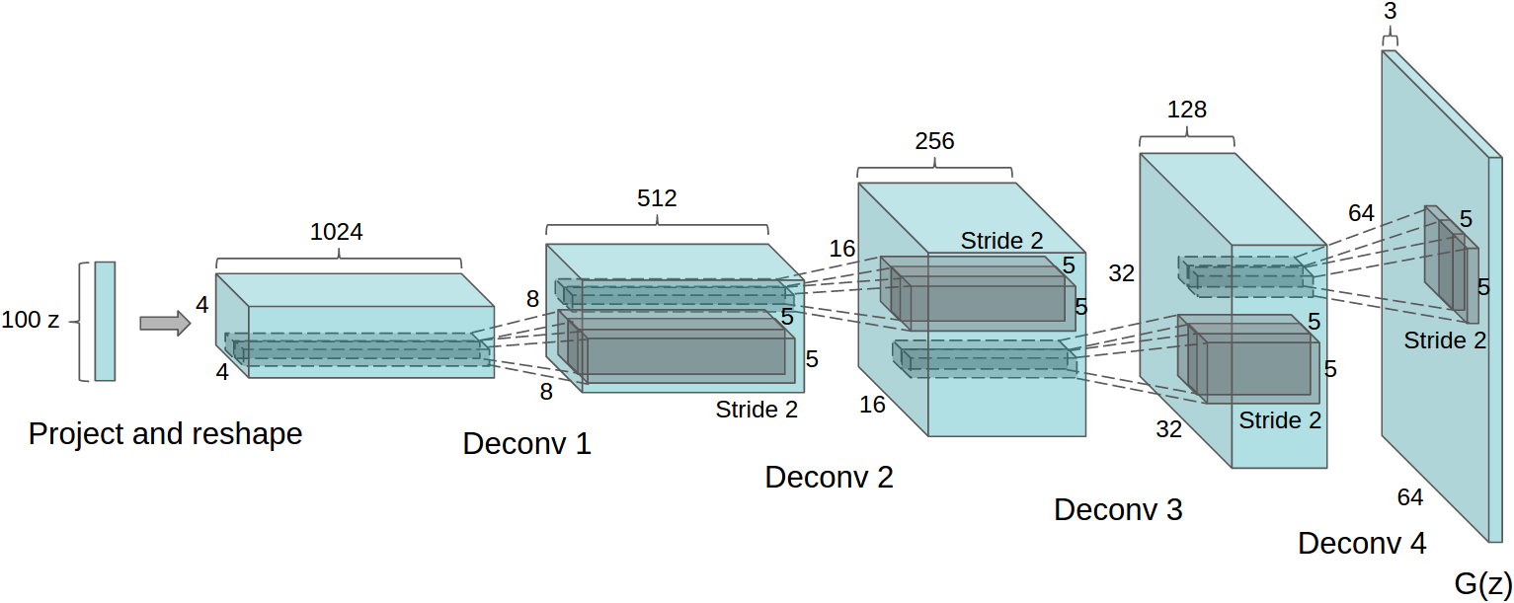
Implementation | DC-GAN
Discriminator - Strided Convolution, Generator – Fractional-strided Convolution
Batch-Normalization
Remove fully connected layers
Generator: ReLU activation for hidden layer, Tanh activation for output.
Discriminator: Leaky ReLU
Training Data: Resized to shape 64x64; Normalized;
Generator Input: 4096 samples from N(0,1) distribution for each image
One Epoch: 500 samples from data and 500 samples from model to train Discriminator
Add noise to some random image labels

Slide 11
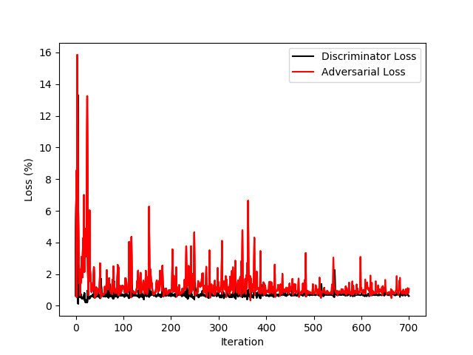
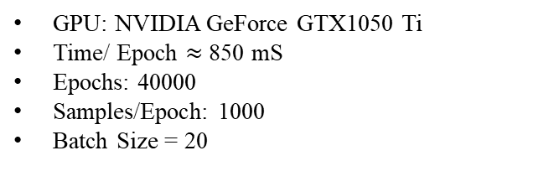
Results | First few epochs
GPU: NVIDIA GeForce GTX1050 Ti
Time/ Epoch $≈$ 850 mS
Epochs: 40000
Samples/Epoch: 1000
Batch Size = 20

Slide 12
Results | After 40000 epochs
Sample from data
Sample from model

Slide 13
References
Ian Goodfellow, Jean Pouget-Abadie, Mehdi Mirza, Bing Xu, David Warde-Farley, Sherjil Ozair, Aaron Courville, and Yoshua Bengio. Generative adversarial nets. In Z. Ghahramani, M. Welling, C. Cortes, N. D. Lawrence, and K. Q. Weinberger, editors, Advances in Neural Information Processing Systems 27, pages 2672–2680. Curran Associates, Inc., 2014. URL http://papers.nips.cc/paper/5423-generative-adversarial-nets.pdf.
Alec Radford, Luke Metz, and Soumith Chintala. Unsupervised representation learning with deep convolutional generative adversarial networks. arXiv preprint arXiv:1511.06434, 2015.
Tim Salimans, Ian Goodfellow, Wojciech Zaremba, Vicki Cheung, Alec Radford, Xi Chen, and Xi Chen. Improved techniques for training gans. In D. D. Lee, M. Sugiyama, U. V. Luxburg, I. Guyon, and R. Garnett, editors, Advances in Neural Information Processing Systems 29, pages 2234–2242. Curran Associates, Inc., 2016. URL http://papers.nips.cc/paper/6125improved-techniques-for-training-gans.pdf.
I. Goodfellow. Nips 2016 tutorial: Generative adversarial networks. arXiv preprint arXiv:1701.00160, 2016.
A. Jolicoeur-Martineau. The relativistic discriminator: a key element missing from standard gan. arXiv preprint arXiv:1807.00734, 2018.

Slide 14
Thank You

Slide 15
Back-up Slides

Slide 16
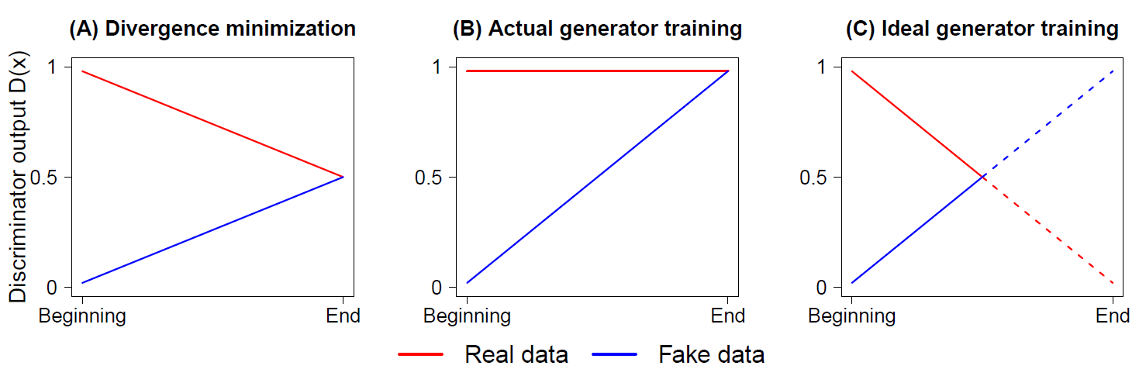
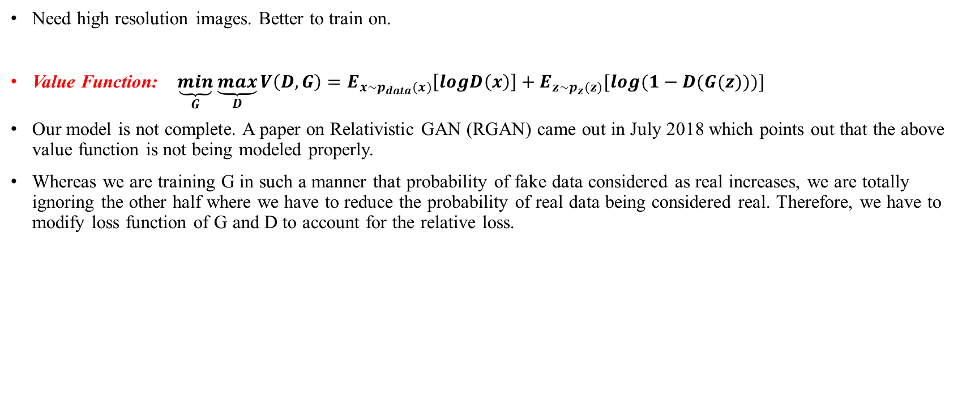
Future work
Need high resolution images. Better to train on.
Value Function: $\underset{G}{\underbrace{min}}\underset{D}{\underbrace{max}}V\left(D,G\right)=E_{x\sim p_{data}(x)}\left[logD\left(x\right)\right]+E_{z\sim p_{z}(z)}[log⁡(1−D(G(z)))]$
Our model is not complete. A paper on Relativistic GAN (RGAN) came out in July 2018 which points out that the above value function is not being modeled properly.
Whereas we are training G in such a manner that probability of fake data considered as real increases, we are totally ignoring the other half where we have to reduce the probability of real data being considered real. Therefore, we have to modify loss function of G and D to account for the relative loss.

Slide 17
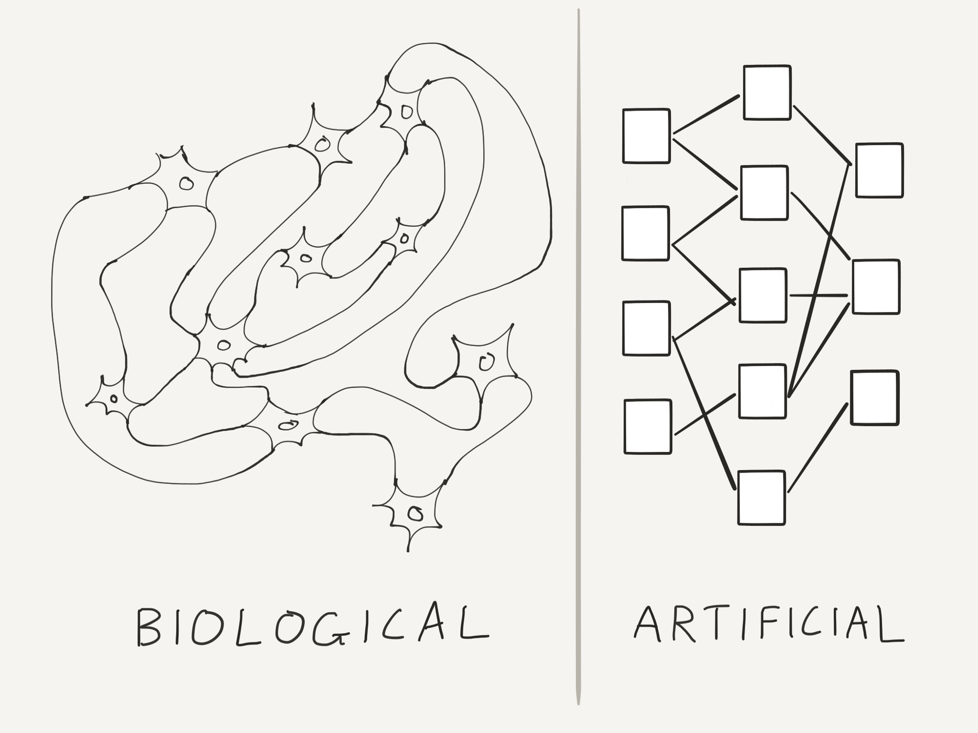
Neural Networks
Neural networks process information in a similar way the human brain does.
The network is composed of a large number of highly interconnected processing elements(neurons) working in parallel to solve a specific problem.

Slide 18
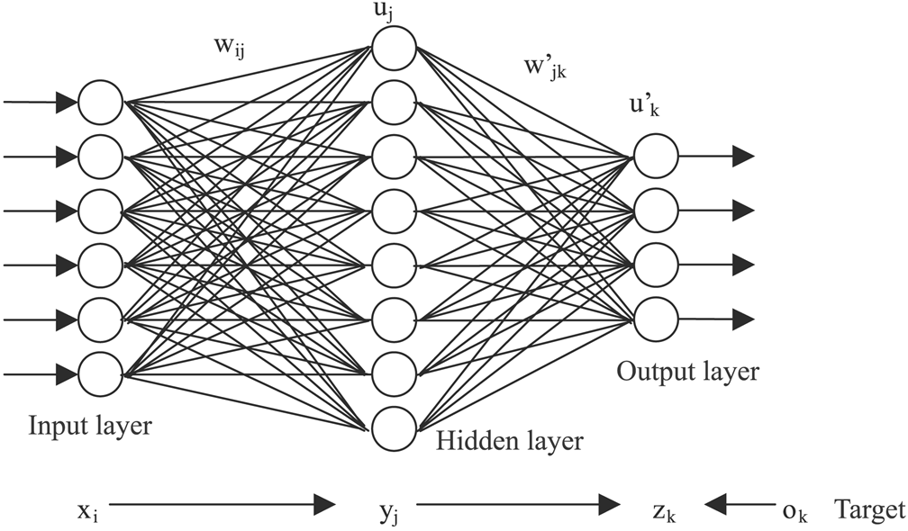
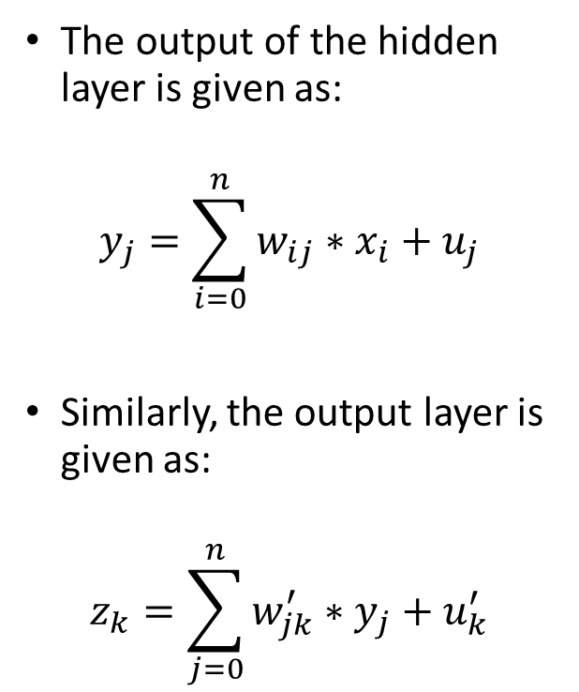
Neural Networks
The output of the hidden layer is given as:
$$y_{j}=\sum_{i=0}^{n}{w_{ij}∗x_{i}+u_{j}}$$
Similarly, the output layer is given as:
$$z_{k}=\sum_{j=0}^{n}{w_{jk}^{′}∗y_{j}+u_{k}^{′}}$$

Slide 19
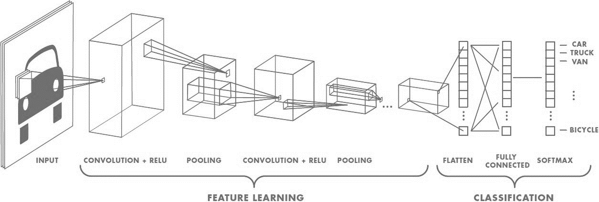
Convolutional Neural Networks

Slide 20
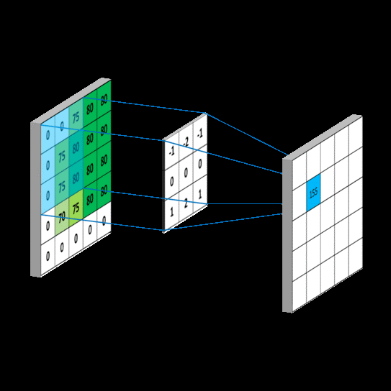
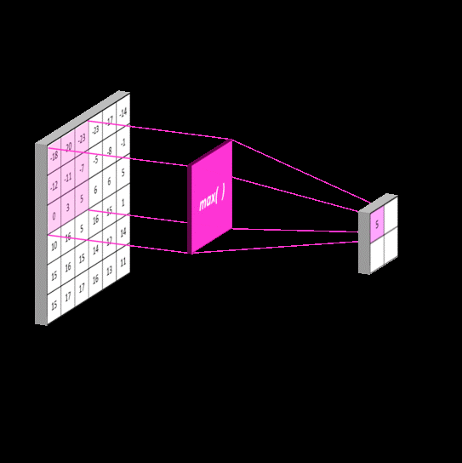

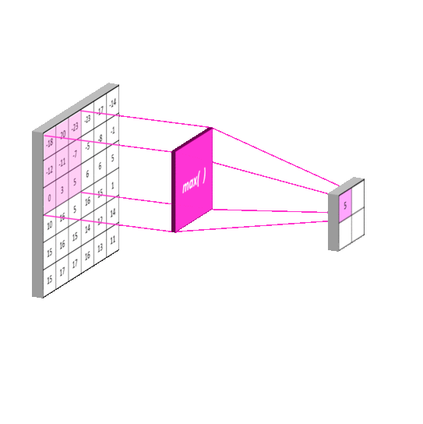
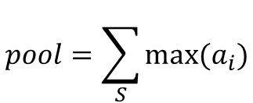

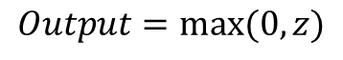
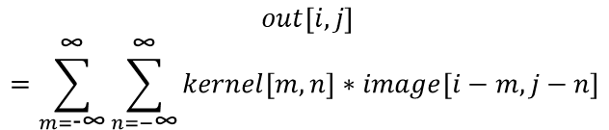
Convolution:
Rectified Linear Units:
Pooling:
$$out\left[i,j\right]$$
$$=\sum_{m=\text{−}\text{∞}}^{\text{∞}}{\sum_{n=−\text{∞}}^{\text{∞}}{kernel\left[m,n\right]∗image[i−m,j−n]}}$$
$$pool=\sum_{S}{max⁡(a_{i})}$$
$$Output=max⁡(0,z)$$

Slide 21
Implementation (Simple CNN)
Dataset : Google’s cartoon dataset (10k images)
Libraries used: numpy, pandas, opencv, glob, matplotlib, sklearn
Optimizer : RMSProp
Learning Rate Reduction
Network Architecture
Flatten
Fully Connected
Convolution
Max Pooling
Dropout
Input
Train: 90% Test: 10%
Output

